Slide 1
Generative Adversarial Network
Introduction to Artificial Intelligent (AI)

Slide 2
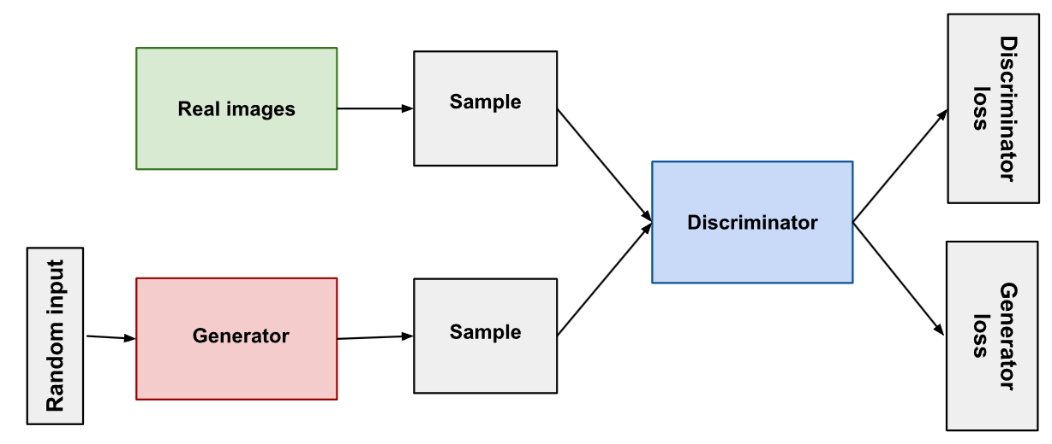
Generative Adversarial Networks
GAN is a deep learning architecture.
GAN trains two neural networks to compete against each other to generate more authentic new data from a given training dataset.

Slide 3
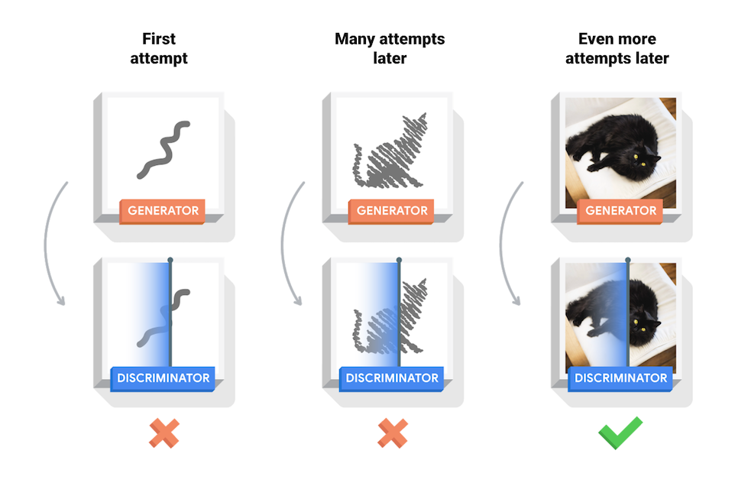
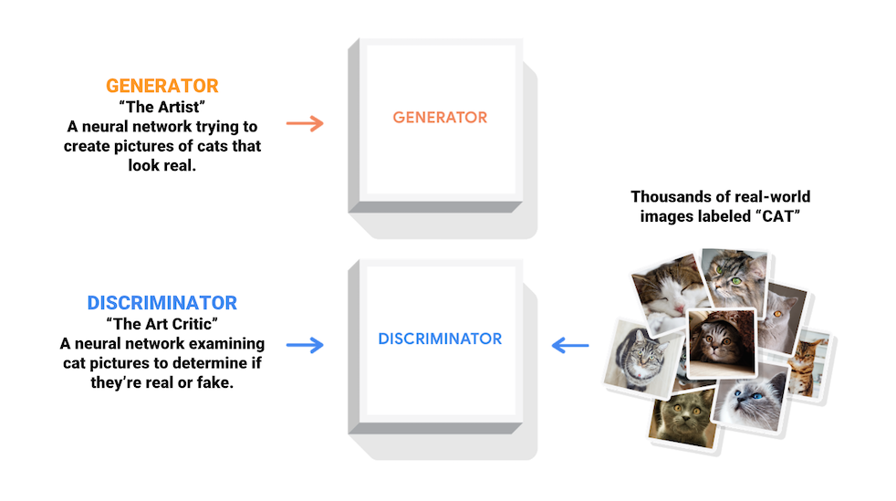
Generative Adversarial Networks

Slide 4
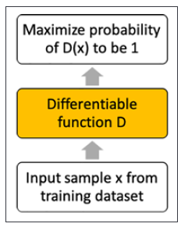
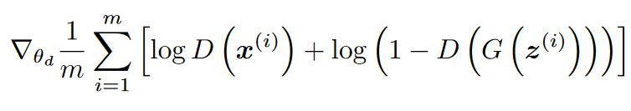
The discriminator
The Discriminator is a classification model.
The discriminator is also used to classify whether the output from the generator is real or fake.
If the discriminator performs significantly better than the generator → Vanishing Gradients
Discriminator loss function
Real sample
Fake sample

Slide 5
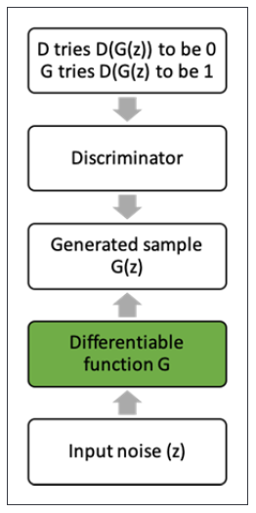

The Generator
The Generator is a generative model.
This model generates samples that are intended to resemble the samples from our training set.
the generator is always trying to find the one output that seems most plausible to the discriminator.
Generator loss function

Slide 6
Training GAN
Train the Discriminator
Set the Discriminator as non-trainable
Train the Generator
Repeat again and again

Slide 7
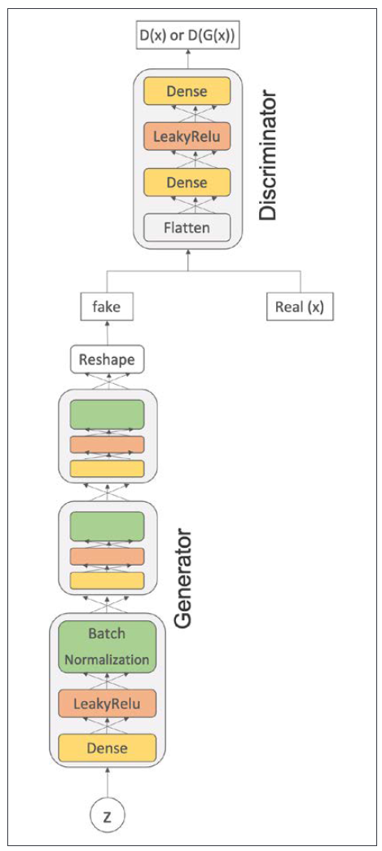
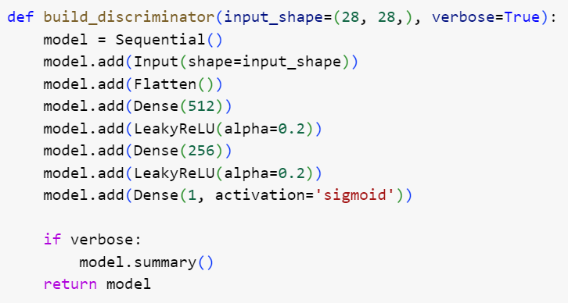
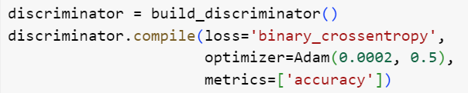
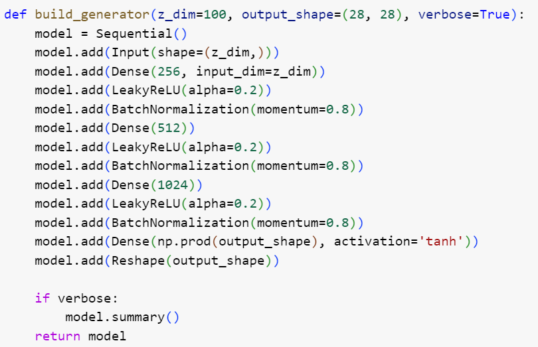
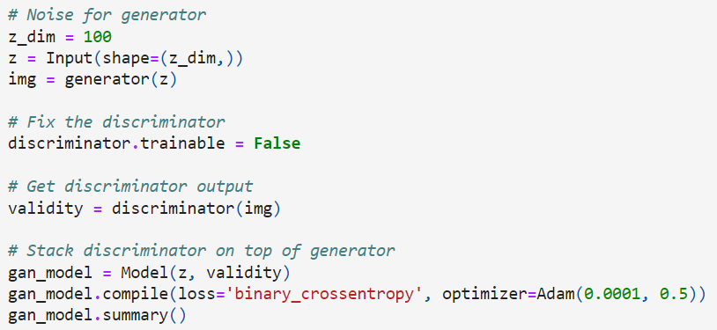
Vanilla GAN

Slide 8
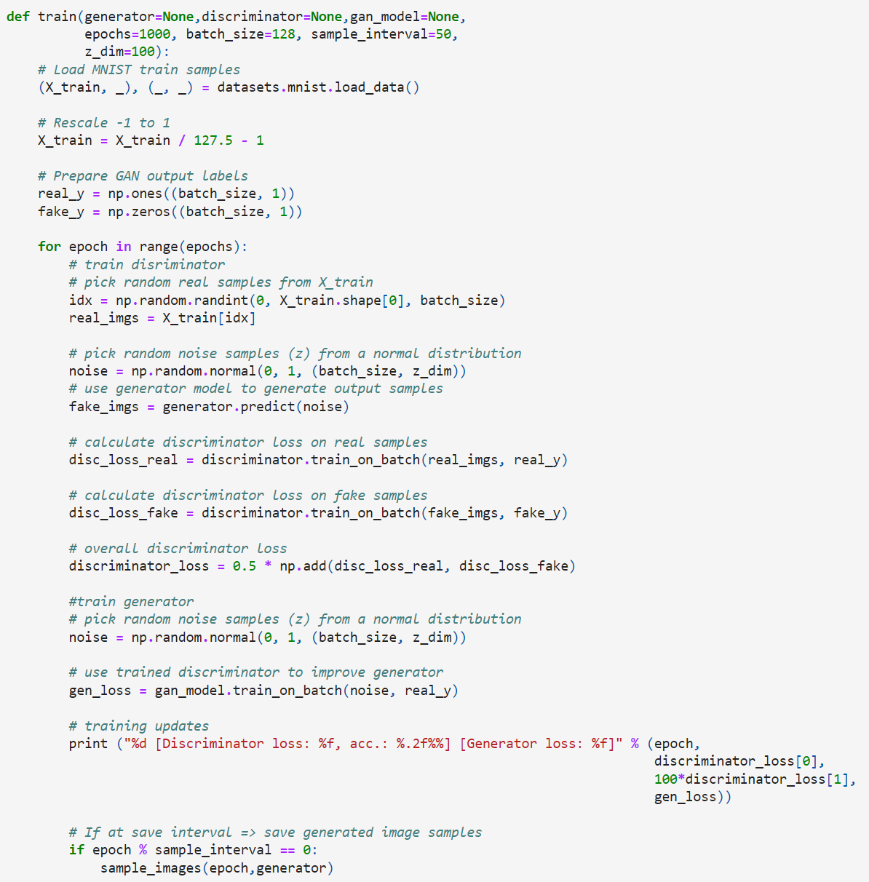
Vanilla GAN

Slide 9
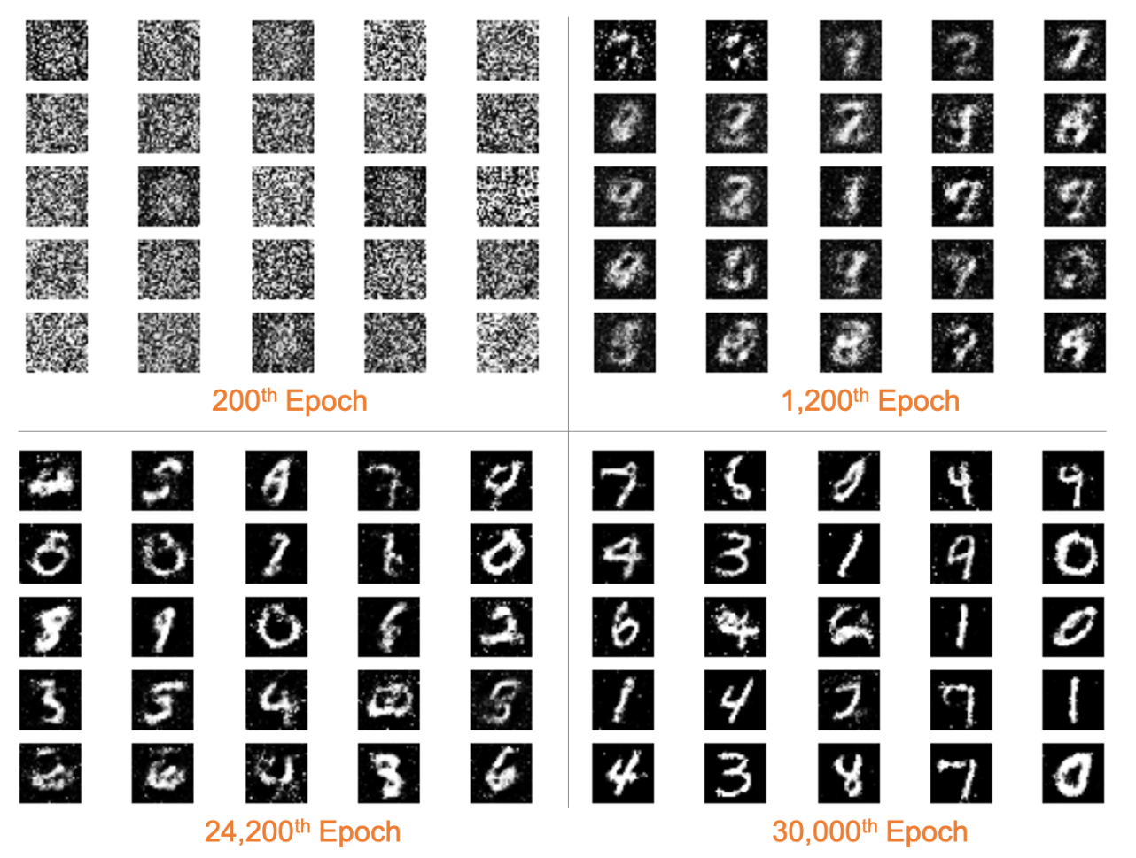
Vanilla GAN

Slide 10
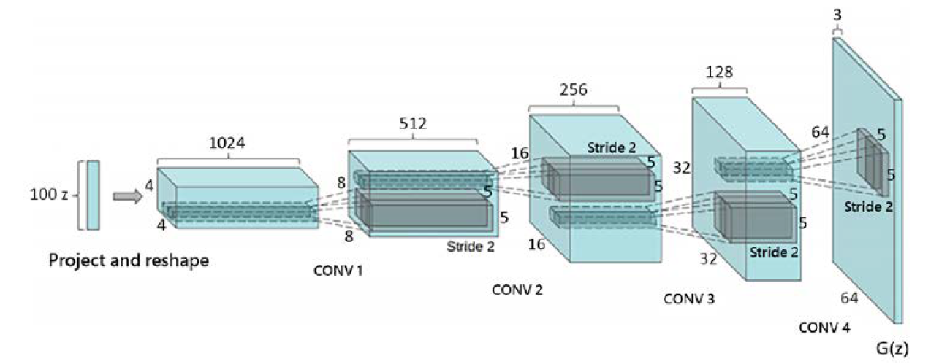
Deep convolution GAN
Deep Convolutional GAN was published in 2016 by Radford et al.
DCGAN emphasized using deeper architectures with Up-sampling layer for the Generator to create high resolution image
DCGAN generator architecture

Slide 11
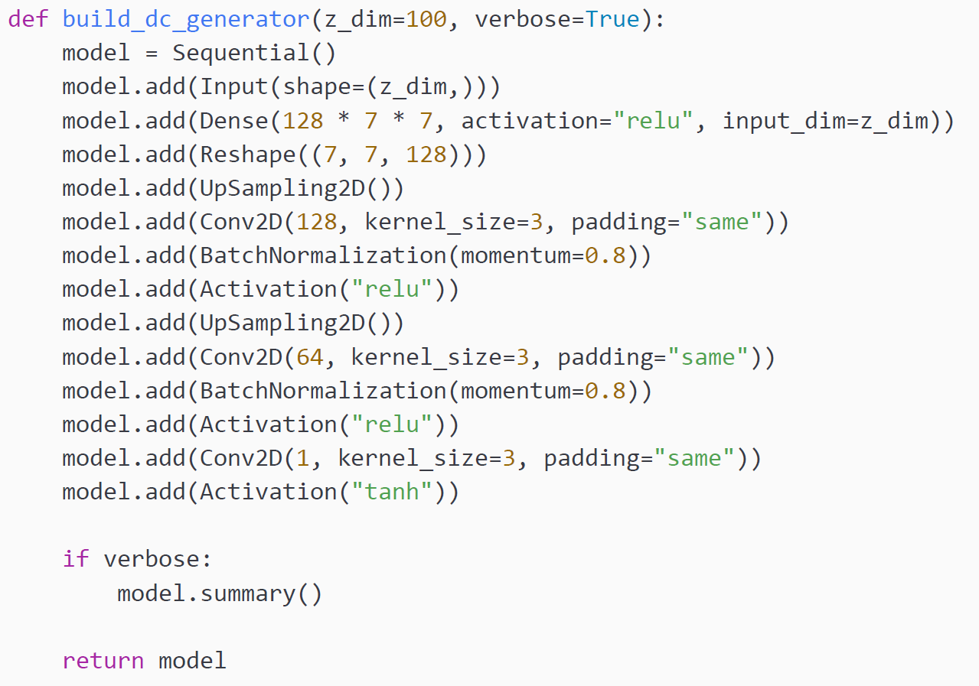
Deep convolution GAN
DCGAN generator architecture

Slide 12
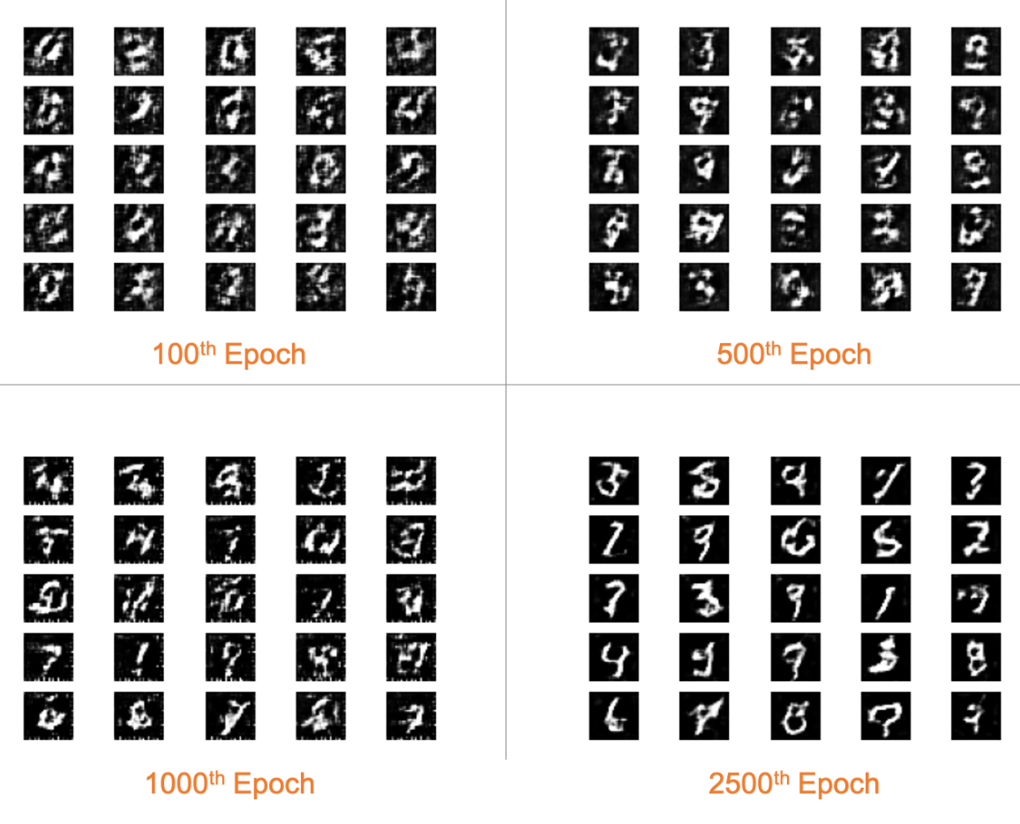
Deep convolution GAN

Slide 13
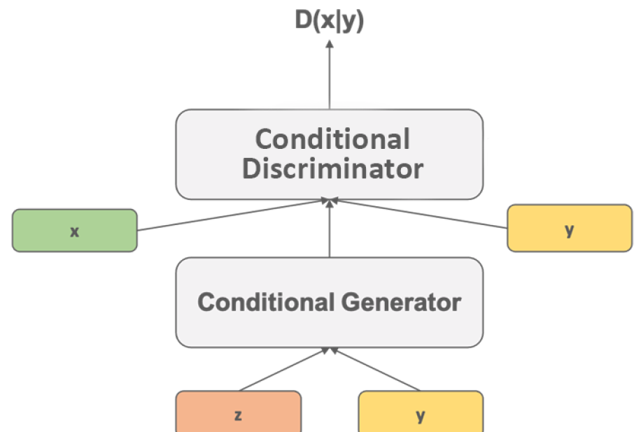
Conditional GAN
Conditional GANs (CGANs) are the class of GANs that provide the control needed to generate a specific output.
CGANs work by training the generator model to generate fake samples conditioned on specific characteristics of the output required

Slide 14
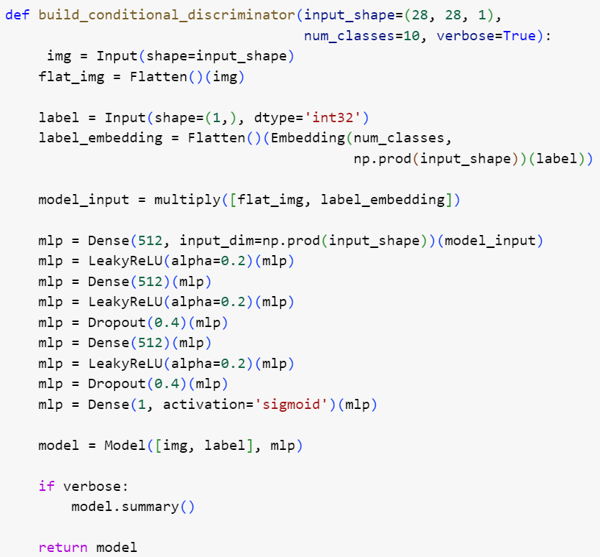
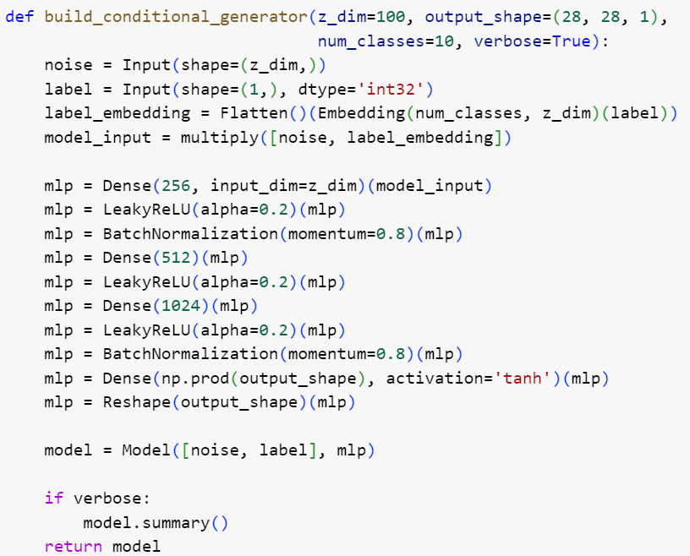
Conditional GAN

Slide 15
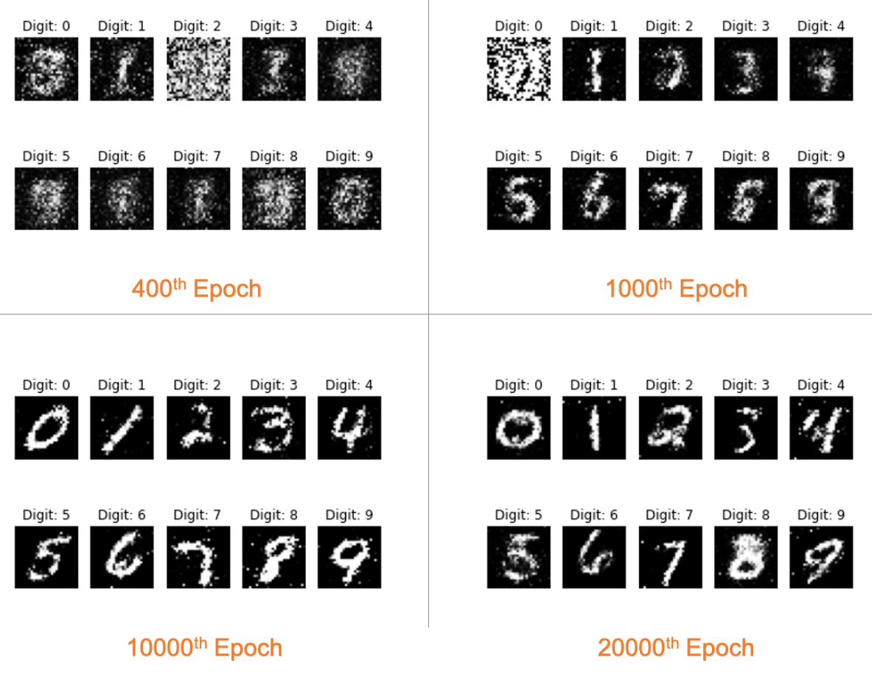
Conditional GAN

Slide 16
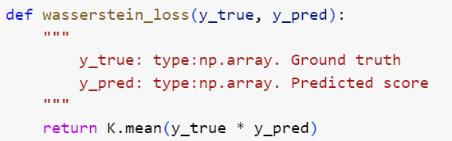
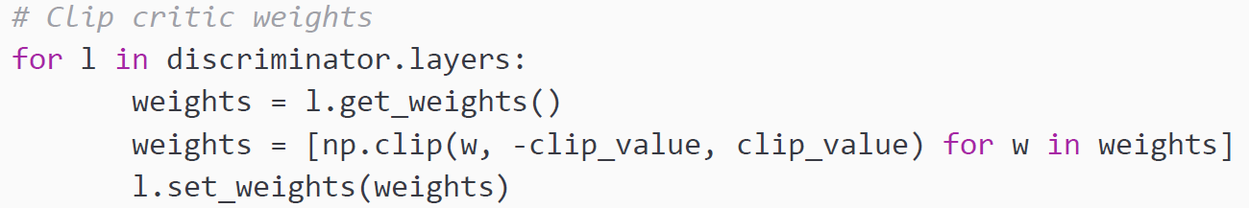
Wasserstein GAN
W-GANs treat the discriminator as a critic
W-GAN discriminator (or critic) generates a score to inform the generator about the realness or fakeness of the input image

Slide 17
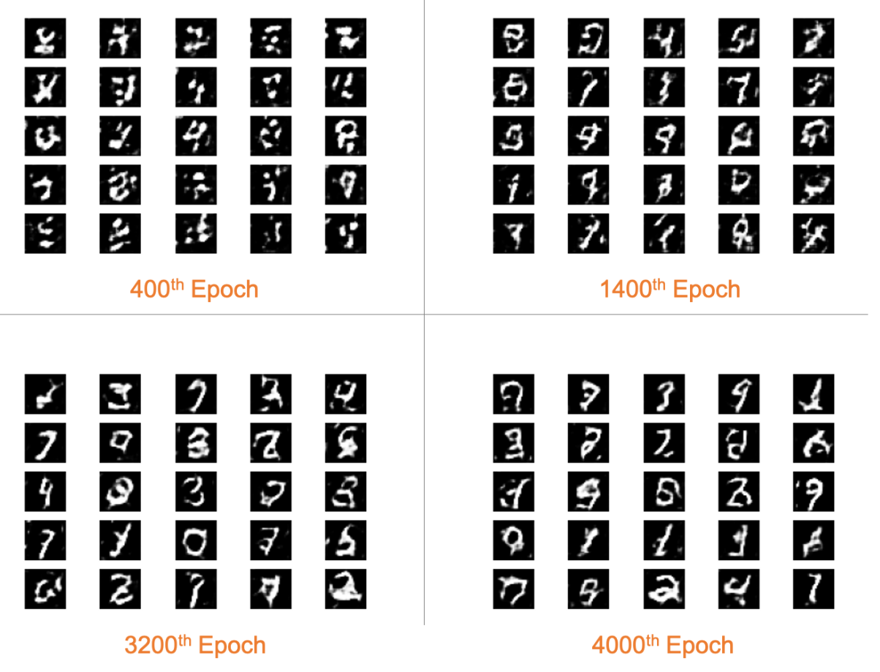
Wasserstein GAN

Slide 18
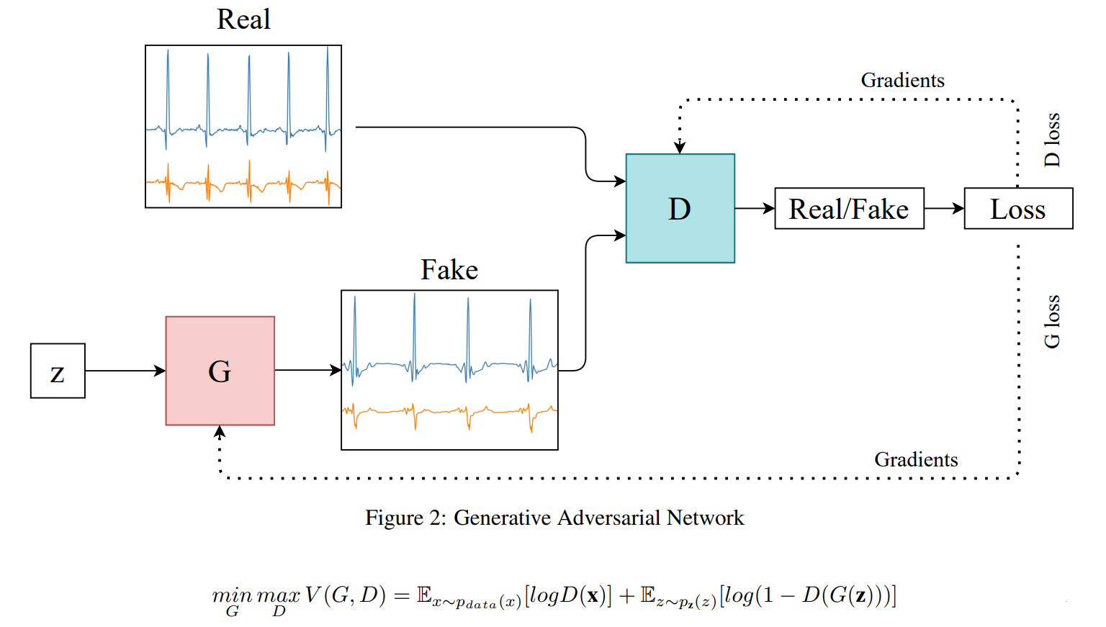
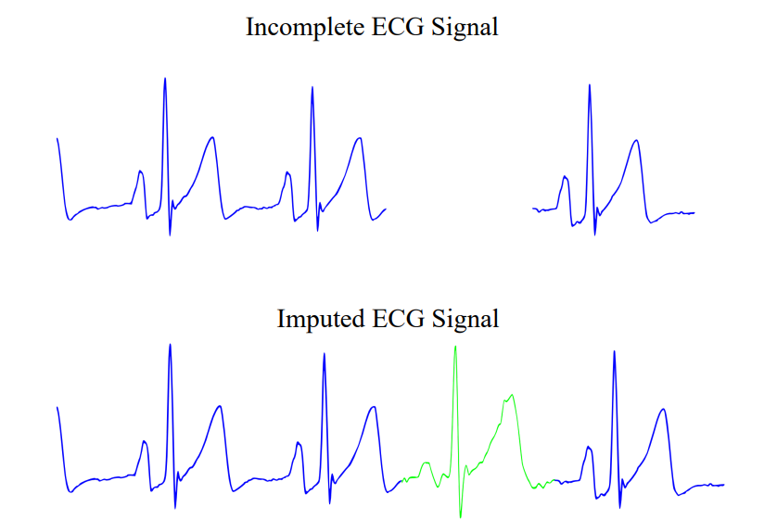
Time-Series GAN

Slide 19
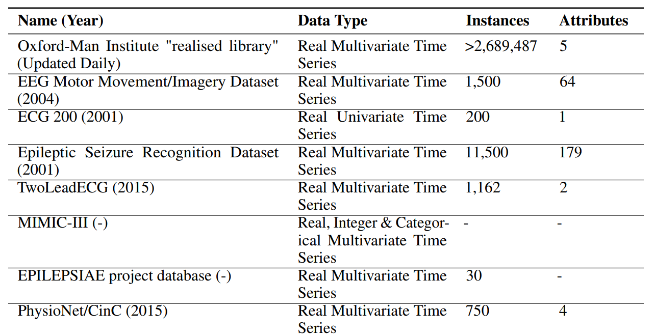
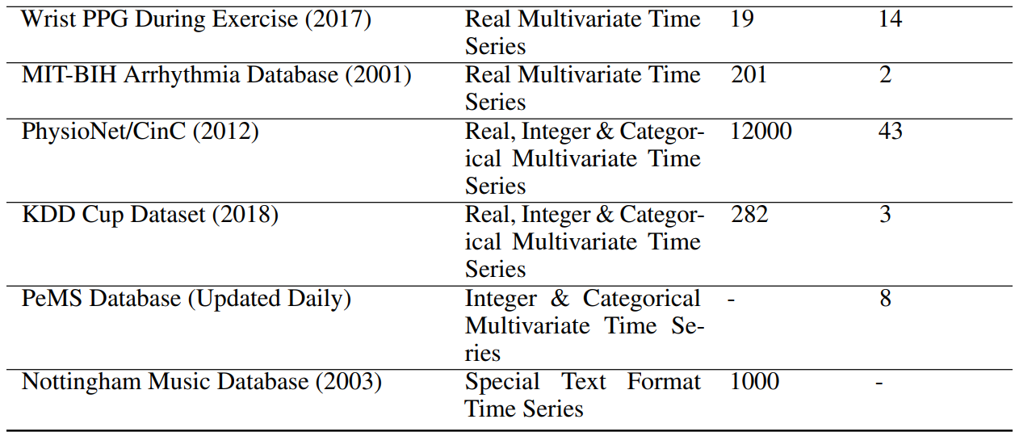
Time-Series GAN
Popular Dataset for Time-series GAN

Slide 20
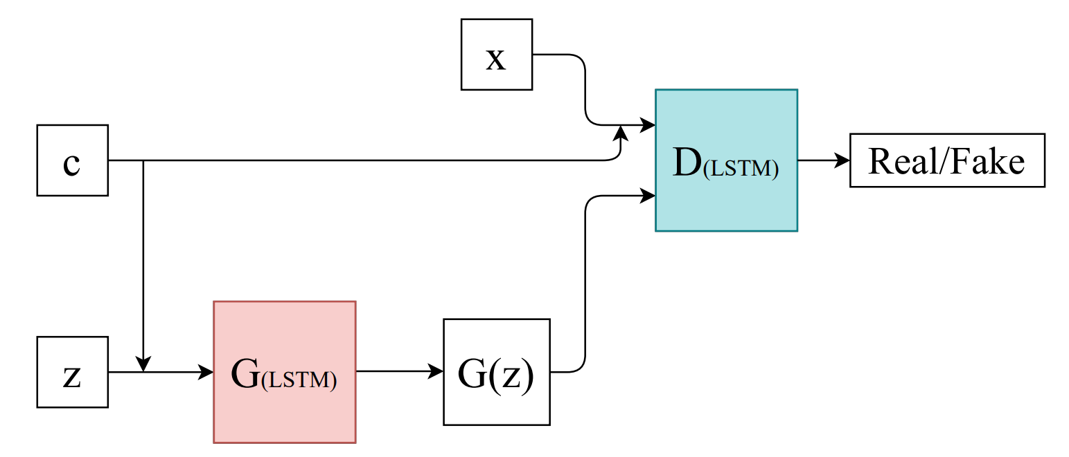
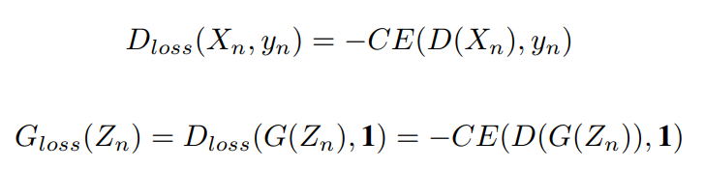
Time-Series GAN
RCGAN architecture with conditional input c, input data x and latent variable z
(2017)

Slide 21
Time-Series GAN
RCGAN architecture with conditional input c, input data x and latent variable z
(2017)

